Slide 1


Slide 2
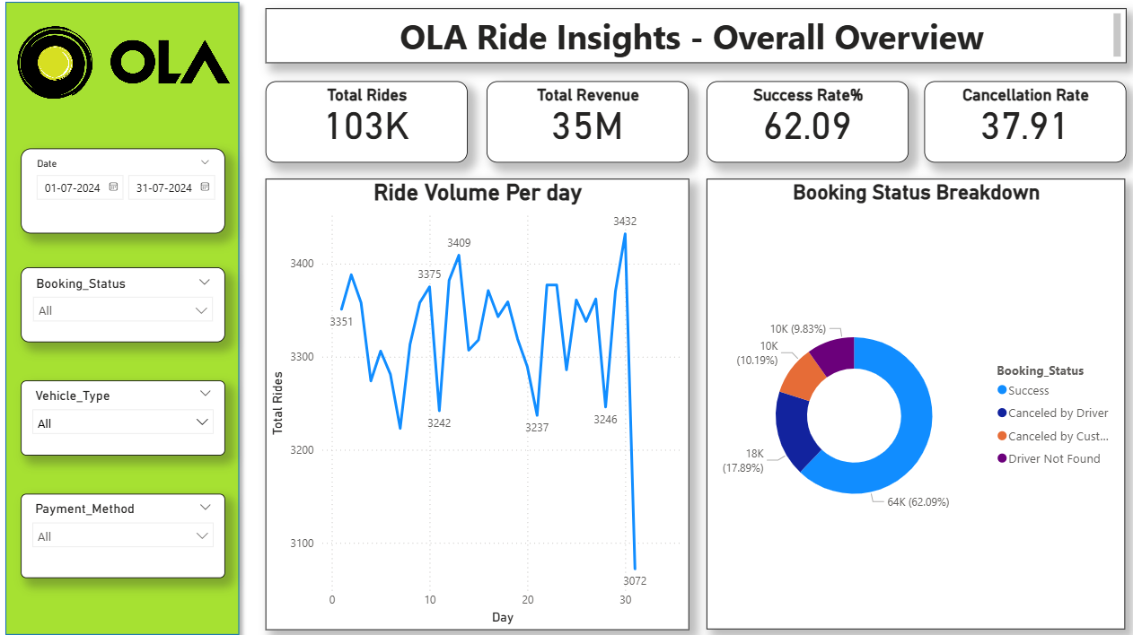
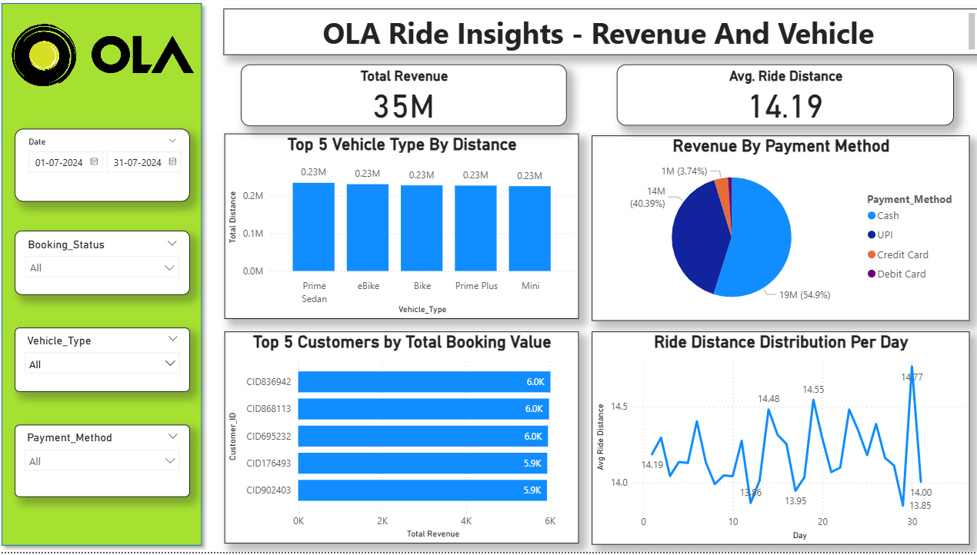
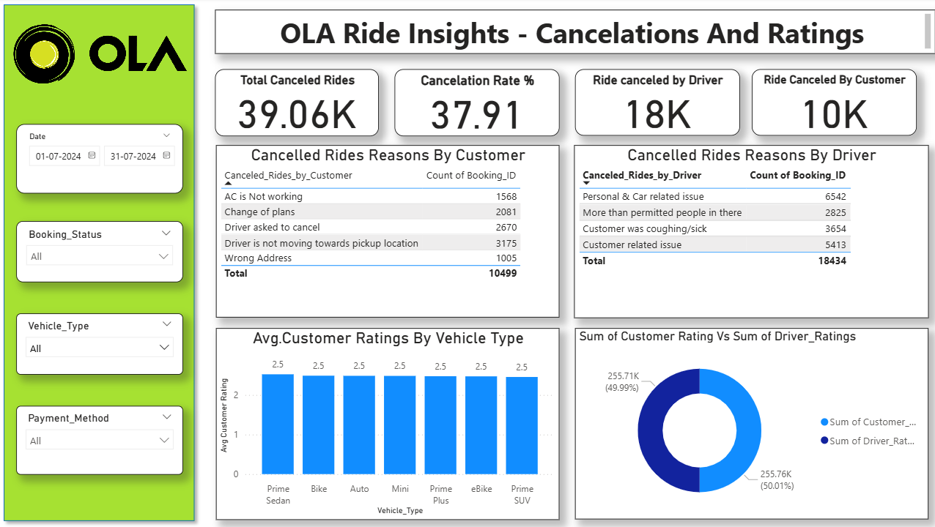
Project Summary
Project Overview:
Analyzed OLA ride data to uncover key business insights related to ride demand, cancellations, revenue trends, payment methods, and customer ratings.
Developed optimized SQL queries to extract insights including ride trends, cancellation analysis, revenue distribution, and rating patterns.
Validated query results to ensure data accuracy and reliability.
Designed an interactive dashboard to visualize key performance indicators (KPIs) and enable dynamic data exploration.
Created 3 pages in Power BI.
Data Cleaning:
Checked the dataset for missing and duplicate value and handled them appropriately.
Standardized column names and ensured consistency in formatting.
Converted data types where required.
Created derived features where necessary to improve analysis and insights.
Ensured the dataset was structured and ready for SQL querying and dashboard visualization.
SQL Query Development:
Wrote SQL queries to extract meaningful business insights from the OLA ride dataset.
Used aggregation functions like COUNT, SUM, AVG, GROUP BY, and ORDER BY for analysis.
Validated results by cross-checking query outputs with dataset values.
Page 1
Page 2
Page 3

Slide 3

Key Performance Indicator (KPI’s)
Create key performance indicators (KPIs) for OLA Ride Analysis.
These Include:
Total Rides :
Calculated by sum of total bookings.
Total Revenue:
Calculated by sum of booking value and booking status(success).
Success Rate%:
Calculated the ride success rate by dividing the number of successful rides by the total number of rides and multiplying by 100.
Total canceled Rides:
Total Cancelled Rides are calculated by counting the distinct Booking IDs where the booking status is not “Success.”
Cancelation Rate%:
Calculated cancellation rate as the percentage of non-successful rides out of total rides.
Theses KPIs help measure overall business performance and enable data-driven decision-making by tracking key metrics such as revenue, and cancellation rate.
Used slicer for Date, Booking status, Payment method and Vehicle type.

Slide 4


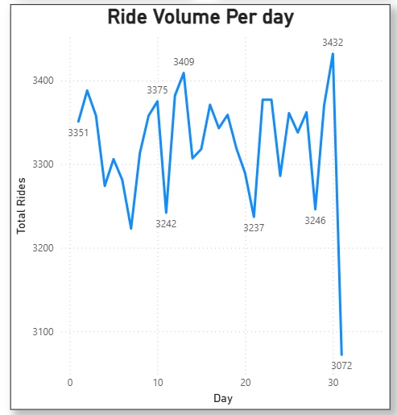



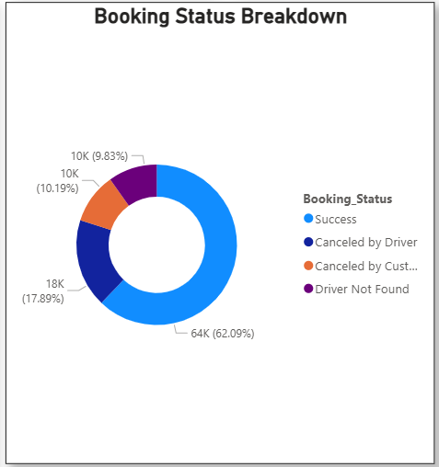


Key Performance Indicator (KPI’s)
Ride Volume Per Day
This visual analyzes daily ride volume trends to understand fluctuations in customer demand and identify peak and low booking days.
Daily ride volume remains relatively stable, averaging around 3,300–3,400 rides per day, indicating consistent demand.
The highest ride volume was recorded at approximately 3,432 rides, showing peak demand on certain days.
The lowest ride volume dropped to around 3,072 rides, indicating a noticeable decline toward the end of the period.
Overall trend suggests steady customer demand with occasional peak booking days.
Overall
Vehicle Type
Revenue
Booking Status Breakdown
This visual shows the distribution of total bookings based on their status. So , use Donut chart to visualize the distribution.
In the visual we can see the majority of rides were successfully completed, accounting for 64K rides (62.09%).
18K rides (17.89%) were cancelled by drivers and 10K rides (10.19%) were cancelled by customers.
Overall cancellation-related cases (driver cancelled, customer cancelled, driver not found) account for approximately 38% of total bookings.
Cancellation
Ratings

Slide 5









Vehicle Type Performance Analysis
Vehicle Type | Total Booking Value | Success Booking Value | Avg. Distance Travelled | Total Distance Travelled
Prime Sedan | 8298612 | 5224050 | 15.76493917 | 234535
Prime SUV | 7933330 | 4876815 | 15.27451382 | 223848
Prime Plus | 8050889 | 5015165 | 15.44747399 | 227186
Mini | 7990996 | 4885961 | 15.5101017 | 225703
Auto | 8092210 | 5051846 | 6.238088783 | 92043
Bike | 7987054 | 4971968 | 15.53307871 | 227746
E-Bike | 8181523 | 5054662 | 15.58058855 | 230842
Overall
Vehicle Type
Revenue
Cancellation
Ratings

Slide 6
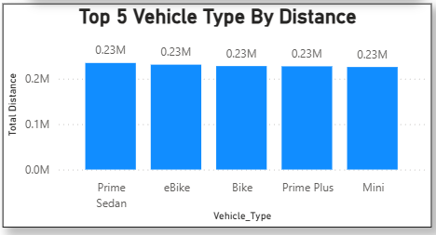
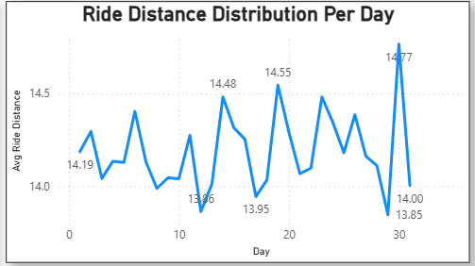
Key Performance Indicator (KPI’s)
Top 5 Vehicle Type By Distance :
To analyze the total ride distance covered by the top five vehicle categories, use column chart to visualize it.
The insights found that all vehicle show nearly equal total distance of approximately 0.23M(230,000 km), indicating balanced usage across categories.
Similar distance distribution suggests consistent customer preference across different ride categories.
Balanced distance contribution across vehicle types reflects operational stability.
Ride Distance Distribution Per Day
To analyze the average ride distance for each day over a one-month period use Line chart to get more details.
Most ride distances fall within a narrow range of approximately 13.85 km to 14.77 km.
The highest average ride distance was observed around Day 30 (~14.77 km).
The lowest average ride distance occurred around Day 29 (~13.85 km).
There are minor daily fluctuations, but no extreme spikes or drops.

Slide 7
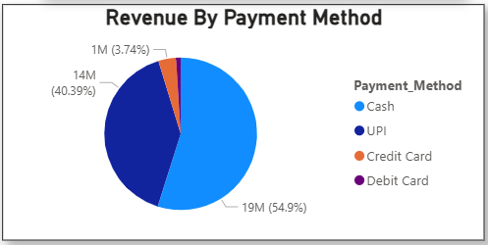

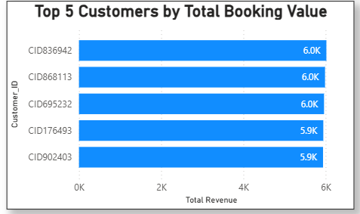
Key Performance Indicator (KPI’s)
Revenue By Payment Method
This chart shows the distribution of total revenue based on different payment methods.
Use Pie Chart for visual.
It helps understand customer payment preferences and digital adoption trends.
Cash contributes the highest revenue share (~54.9%, 19M).
UPI is the second-largest contributor (~40.39%, 14M)
Credit Card contributes a small share (~3.74%, 1M).
Revenue is heavily concentrated in Cash and UPI, indicating these are the dominant payment preferences.
Overall
Vehicle Type
Revenue
Top 5 Customers By Total Booking Value
Use Bar chart to know the Top 5 customers based on their total booking value.
It helps identify high-value customers who contribute significantly to overall revenue.
The analysis is based on total revenue generated per customer ID.
The top 3 customers (CID836942, CID868113, CID695232) each generated approximately 6.0K in total booking value.
The next 2 customers (CID176493 and CID902403) contributed slightly lower but similar values of around 5.9K.
There is no large gap between customers, indicating balanced revenue contribution among top users.
Cancellation
Ratings

Slide 8
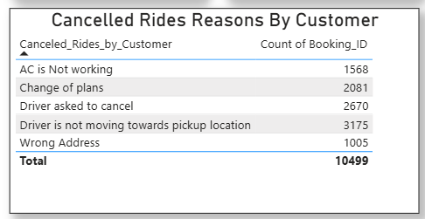
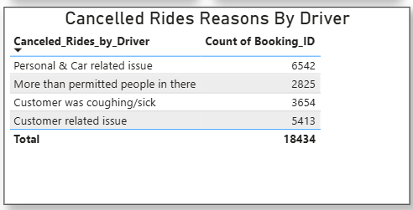

Key Performance Indicator (KPI’s)
Cancelled Rides Reasons By Customer
This table shows the main reasons why customers cancelled their rides.
The most common cancellation reason is “Driver is not moving towards pickup location” with 3,175 cancellations, indicating possible driver delays.
The second highest reason is “Driver asked to cancel” with 2,670 cancellations, highlighting potential driver-related service issues.
The total number of cancelled rides is 10,499, showing a significant impact on operations and revenue.
Overall
Vehicle Type
Revenue
Cancelled Rides Reasons By Driver
This table shows the main reasons why drivers cancelled rides.
It helps identify driver-side operational challenges and service limitations.
The most common reason is “Personal & Car related issue” with 6,542 cancellations, indicating vehicle problems or driver availability issues.
The second highest reason is “Customer related issue” with 5,413 cancellations, showing conflicts or issues related to customers.
The total driver cancellations are 18,434, which is significantly higher than customer cancellations.
Cancellation
Ratings

Slide 9

Average Rating for Vehicle Type
Overall
Customer Rating
Prime Sedan | Prime SUV | Prime Plus | Mini | Auto | Bike | E-Bike
2.522746521 | 2.455025589 | 2.47407357 | 2.482373557 | 2.484384954 | 2.487757468 | 2.47087608
Vehicle Type
Revenue
Driver Rating
Prime Sedan | Prime SUV | Prime Plus | Mini | Auto | Bike | E-Bike
2.515870135 | 2.458955988 | 2.46684572 | 2.479315558 | 2.487570315 | 2.482321648 | 2.482579644
Cancellation
Ratings

Slide 10
Insights and Recommendation
Insights:
The insights found that daily ride demand remains stable with minor fluctuations, indicating consistent customer usage.
Approximately 62% of rides are successfully completed, while around 38% result in cancellations or driver unavailability, highlighting operational gaps.
Driver cancellations contribute significantly to total cancellations, impacting overall success rate.
Vehicle categories show balanced distance coverage, indicating diversified customer preferences across ride types.
Revenue performance is directly linked to ride completion rate and cancellation reduction.
Customer ratings indicate overall service performance and influence platform reliability perception.
Recommendation:
Improve driver allocation and availability during peak demand hours to minimize “Driver Not Found” cases.
Implement predictive demand analysis to optimize driver distribution across locations.
Introduce cancellation penalty policies (if applicable) to discourage unnecessary ride cancellations.
Implement real-time monitoring of ride status to quickly address operational disruptions.
Monitor low-performing vehicle categories and redesign promotional strategies accordingly.
Improve communication between drivers and customers to minimize misunderstandings and last-minute cancellation.

Slide 11
Thank You

